Slide 1




Year 1 and Year 2

Slide 2
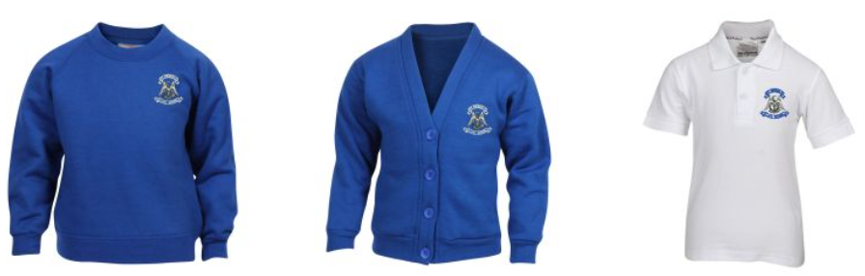
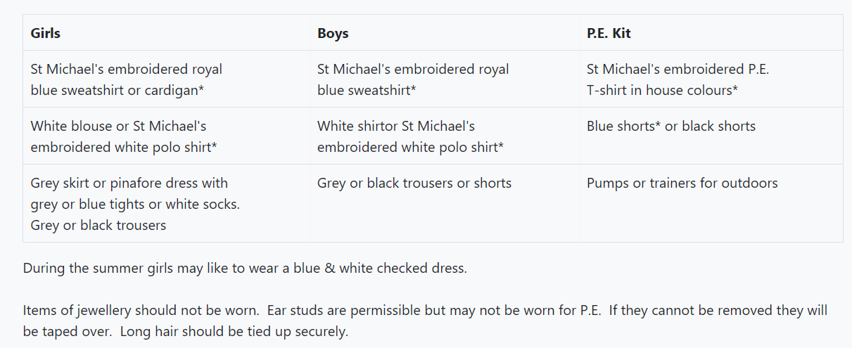
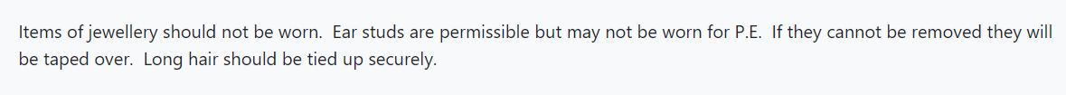
Uniform
* Please make sure that all your child’s clothes and belongings are named.
* We would appreciate your support in ensuring the children wear their correct school uniform as outlined on the school website.

Slide 3
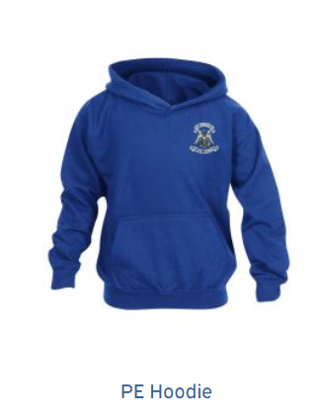
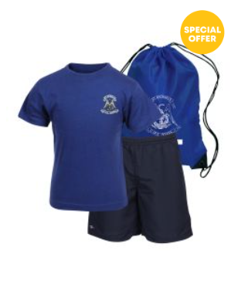
P.E
PE Days
Poldhu – Friday
Kynance – Monday
Porthleven - Wednesday.
* Please leave P.E kits in school for half a term. We will send them home earlier if they get muddy!
Please note: Hoodies are part of the PE uniform and should not be worn as school jumper.

Slide 4
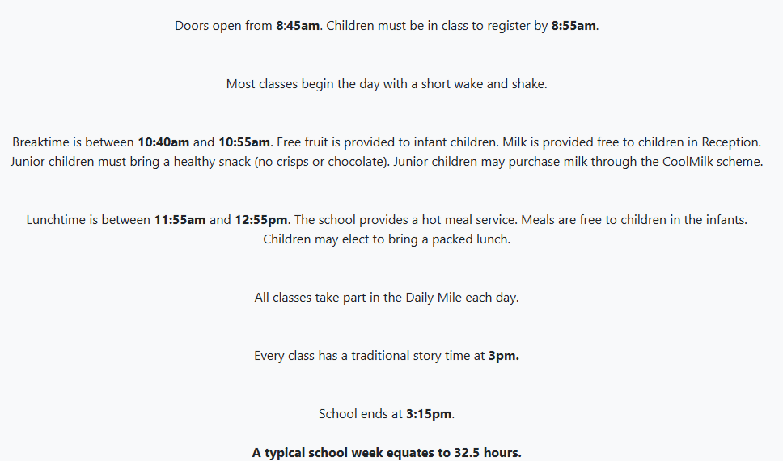
Day to Day Info

Slide 5

Attendance
Registration is open from 8.45am to 8.55am.
All gates will close at 8.55am. Children arriving late, will need to sign in at the main office.
It is the parents' responsibility to contact the school office ,by 10am, on the first day of their child’s absence.
1170 sessions, last year, with no contact made by parents.

Slide 6


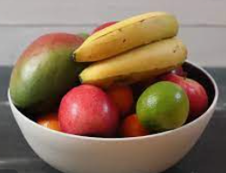
School Meals
£2.65
School meals can be booked via ParentPay before midnight the day before.
Fruit is provided for infant children. Junior children should bring a healthy snack from home.
All children to bring in a water bottle.

Slide 7
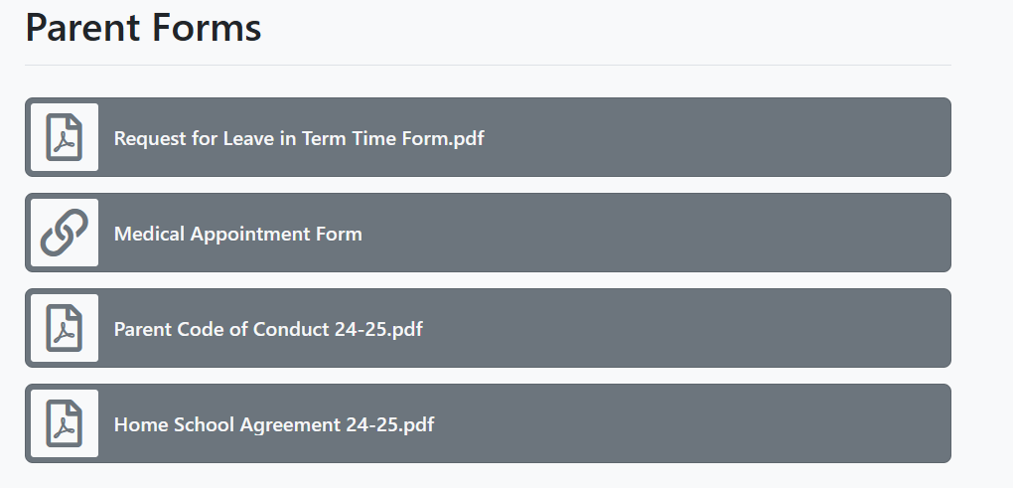
Parent Forms
Medical Appointment Forms, Leave of Absence Forms and Medication Forms can be accessed via the website or collected from the school office.
Medical appointments should be made outside of school hours when possible.

Slide 8
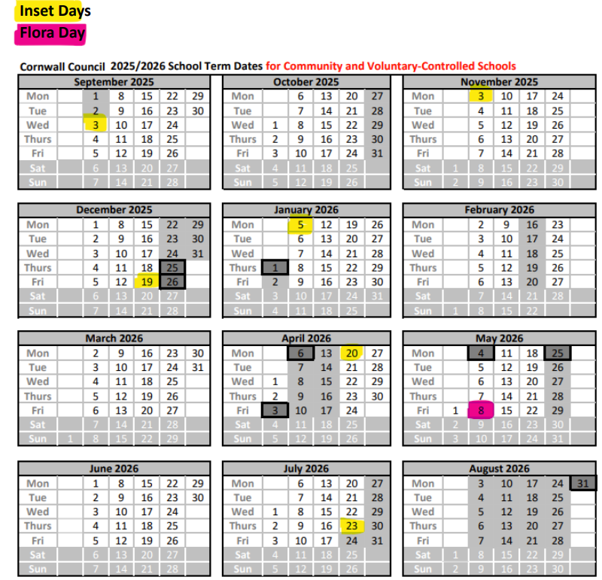
Term Dates
Calendar can be found on the school website.

Slide 9
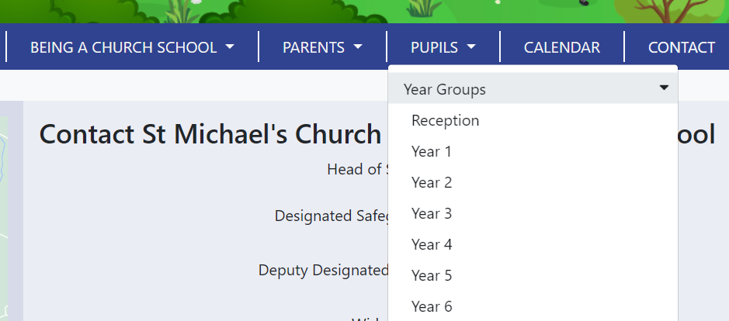
Website and Contact
Please regularly check the class pages on the school websites for dates, updates and photographs.
https://www.st-michaels-helston.org - click on the PUPILS tab then Year Groups.
All teachers will be available on the door each morning.
If you have any concerns or if there is anything you would like to discuss and would like make an appointment with your child’s teacher, please email the advice line:
mic-advice@rainbowacademy.org.uk

Slide 10
Teachers and Support Staff
Kynance – Mrs Saint , Mrs Swift and Mrs Boucher
Porthleven – Miss Care and Mrs Bowler
Poldhu – Mrs Stott and Mrs Gillott

Slide 11
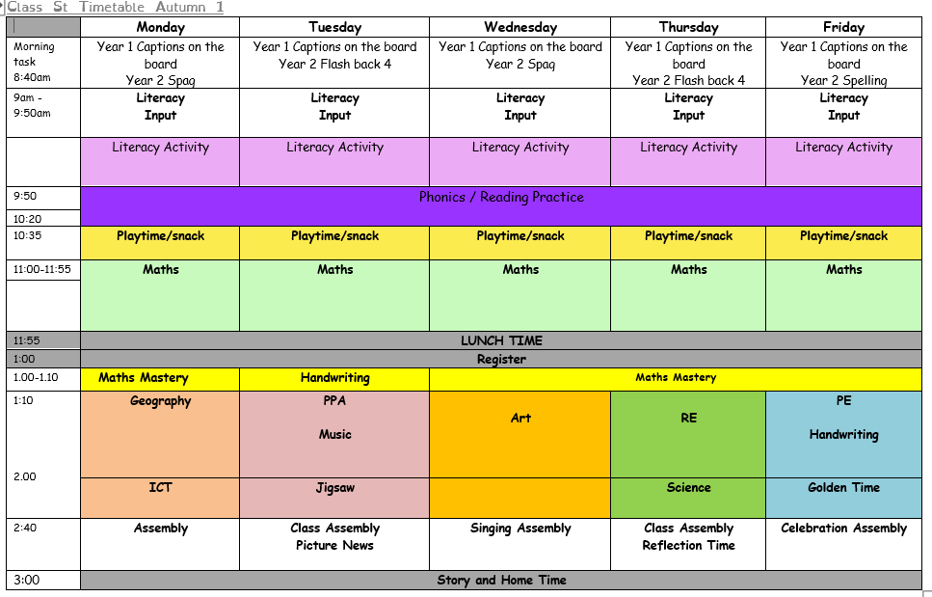
Timetable

Slide 12

Little Wandle Phonics
Phonics happens daily.
It’s a whole class approach
We will keep you informed of your child’s journey in learning to read. You will receive half termly trackers.
Interventions run for children that need support to keep up. This will happen daily.
If your child needs interventions, we will inform you, so you can support at home.
Remember: phoneme is the sound made by the single letter.
Digraph/trigraph: 2/3 letters making one sound.
Grapheme is what it looks like. ai

Slide 13
Little Wandle Phonics Year 1
Your child will move on from Phase 2, 3 and 4 that they learnt in Reception and begin to learn the alternative sounds in Phase 5.
For parents | Letters and Sounds (littlewandlelettersandsounds.org.uk)
You will receive a letter each week, detailing the sounds we have learnt and the words they can be found in. Please use the flash cards to support your child at home.
As your child learns the new sounds, their reading books will reflect this.
Fluency is important. We want to move away from sounding out, to reading the word automatically….fluently.

Slide 14
Little Wandle Year 2
Daily programme.
This term they will recap phase 5 learning from Year 1. We will inform you of their progress half termly.
If interventions are needed then they will start a 14 week Rapid Catch up programme.
Once they have completed Little Wandle, they will move onto the spelling programme. (Autumn 2)
Half termly spelling quiz. You will be informed of their progress, to support at home.
Fluency continues to be the key focus for reading.

Slide 15

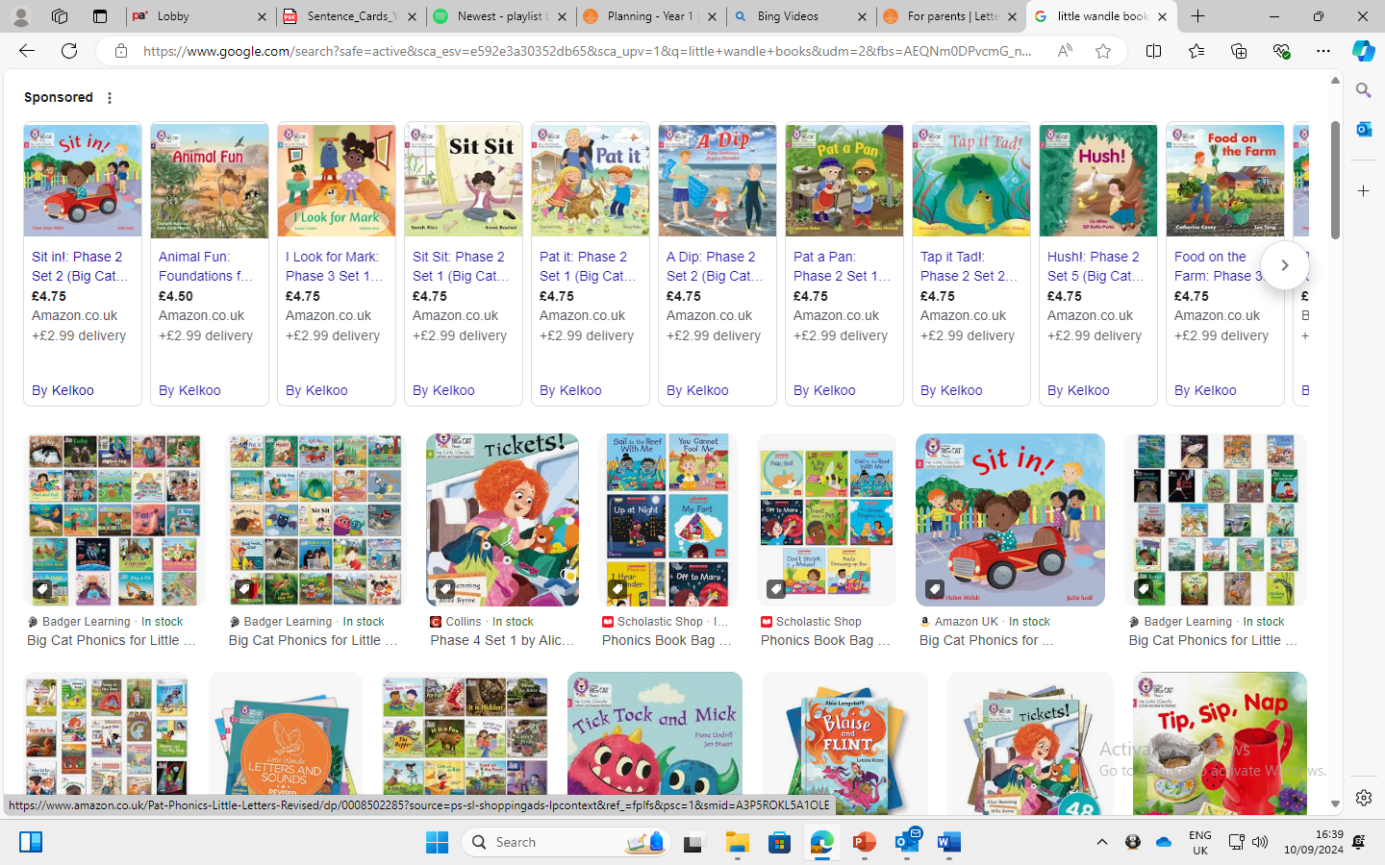


Reading Books - Infants
Reception and Year 1, plus rapid programme in Year 2.
Little Wandle decodable books:
We teach children to read through reading practice sessions three times a week
decoding: sounding out/ building to reading automatically.
prosody: teaching children to read with understanding and expression
comprehension: teaching children to understand the text
  In Year 2,
The next step is to begin a Fluency reading programme.
Chapter books, reading a chapter a day, over two weeks.

Slide 16

Reading at home - Infants
There are two types of books that we send home each week:
The decodable reading practice book is taken home, once they have read it 3 times in school, to ensure success is shared with the family. Kept all week to develop fluency and prosody. Your child should be able to read this book mostly fluently to you, as they have already practised it in school. They are celebrating their great reading with you at home.
Reading for pleasure books also go home for parents to share and read to children. The children choose these themselves from our school libraries.
We will be using paper reading diaries this year. Please record your child's reading daily. This will be checked by an adult throughout the week.

Slide 17




The School Libraries and Beyond
We are very fortunate to have two wonderful library spaces at St Michael's, as well as a multitude of book spaces spread across both key stages. These are being constantly updated with new and exciting texts.
We also encourage the children to access a range of different texts, to develop their reading for pleasure interests and ask that you support them with this, where possible, outside of school.
Donations of quality and up to date novels, non-fiction texts, recipe books, magazines, comics etc, are always welcomed at school.
Please pass any donations to your child's class teacher.

Slide 18

Please take the time to read with your child and provide them with opportunities to engage with a range of text types.
We are their greatest role model.​
The impact is priceless.

Slide 19
Maths
At St Michael's we understand the importance of fluency and how a strong grasp of number and times table knowledge can support the working memory.
In EYFS and KS1, children will be engaging with Mastering Number daily fluency sessions and there will be more information regarding this and how you can support this at home as the year progresses.
.

Slide 20


©Ks2history 2018

